Slide 1
Object-Oriented Programming
Dr. Cemil OZ
Lecture 1: Course Introduction

Slide 2
outline
Syllabus
Course textbooks and materials (Yararlanılacak Kaynaklar)
Grading (Not değerlendirme)
Special needs(Özel ihtiyaçlar)
Topics to be covered(konular)

Slide 3
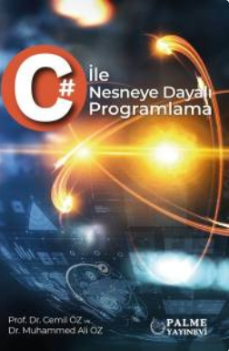
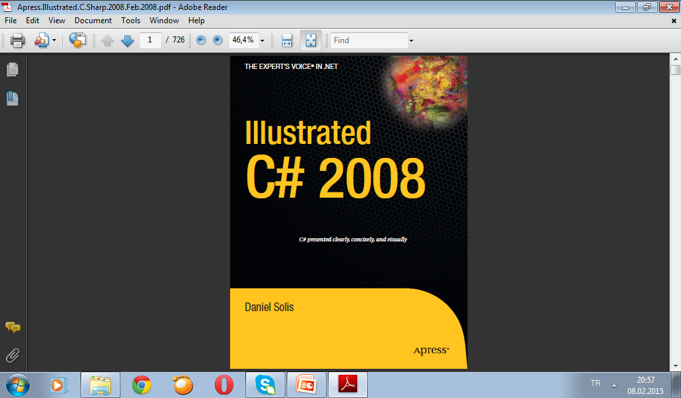

Slide 4
History of C and C++
History of C
Evolved from two other programming languages
BCPL and B
“Typeless” languages
Dennis Ritchie (Bell Laboratories) in the early 1970s
Added data typing, other features
Development language of UNIX
Hardware independent
Portable programs
1989: ANSI standard
1990: ANSI and ISO standard published
ANSI/ISO 9899: 1990

Slide 5
History of C and C++
History of C++
Extension of C
Early 1980s: Bjarne Stroustrup (Bell Laboratories)
“Spruces up” C
Provides capabilities for object-oriented programming
Objects: reusable software components
Model items in real world
Object-oriented programs
Easy to understand, correct and modify
Hybrid language
C-like style
Object-oriented style
Both

Slide 6
C++ Standard Library
C++ programs
Built from pieces called classes and functions
C++ standard library
Rich collections of existing classes and functions
“Building block approach” to creating programs
“Software reuse”

Slide 7
Java
Java
1991: Sun Microsystems
Green project
1995: Sun Microsystems
Formally announced Java at trade show
Web pages with dynamic and interactive content
Develop large-scale enterprise applications
Enhance functionality of web servers
Provide applications for consumer devices
Cell phones, pagers, personal digital assistants, …

Slide 8
Visual Basic, Visual C++ and C#
BASIC
Beginner’s All-Purpose Symbolic Instruction Code
Mid-1960s: Prof. John Kemeny and Thomas Kurtz (Dartmouth College)
Visual Basic
1991
Result of Microsoft Windows graphical user interface (GUI)
Developed late 1980s, early 1990s
Powerful features
GUI, event handling, access to Win32 API, object-oriented programming, error handling
Visual Basic .NET

Slide 9
Visual Basic, Visual C++ and C#
Visual C++
Microsoft’s implementation of C++
Includes extensions
Microsoft Foundation Classes (MFC)
Common library
GUI, graphics, networking, multithreading, …
Shared among Visual Basic, Visual C++, C#
.NET platform
Web-based applications
Distributed to great variety of devices
Cell phones, desktop computers
Applications in disparate languages can communicate

Slide 10
Visual Basic, Visual C++ and C#
C#
Anders Hejlsberg and Scott Wiltamuth (Microsoft)
Designed specifically for .NET platform
Roots in C, C++ and Java
Easy migration to .NET
Event-driven, fully object-oriented, visual programming language
Integrated Development Environment (IDE)
Create, run, test and debug C# programs
Rapid Application Development (RAD)
Language interoperability

Slide 11
Other High-level Languages
FORTRAN
FORmula TRANslator
1954-1957: IBM
Complex mathematical computations
Scientific and engineering applications
COBOL
COmmon Business Oriented Language
1959: computer manufacturers, government and industrial computer users
Precise and efficient manipulation of large amounts of data
Commercial applications

Slide 12
Other High-level Languages
Pascal
Prof. Niklaus Wirth
Academic use

Slide 13
Basics of a Typical C++ Environment
Phases of C++ Programs:
Edit
Preprocess
Compile
Link
Load
Execute
Editor
Program is created in
the editor and stored
on disk.
Disk
Preprocessor
Disk
Preprocessor program
processes the code.
Compiler creates
object code and stores
it on disk.
Compiler
Disk
Linker links the object
code with the libraries,
creates a.out and
stores it on disk
Linker
Disk
Primary
Memory
Loader
Loader puts program
in memory.
Disk
.
.
.
.
.
.
Primary
Memory
CPU
CPU takes each
instruction and
executes it, possibly
storing new data
values as the program
executes.
.
.
.
.
.
.

Slide 14
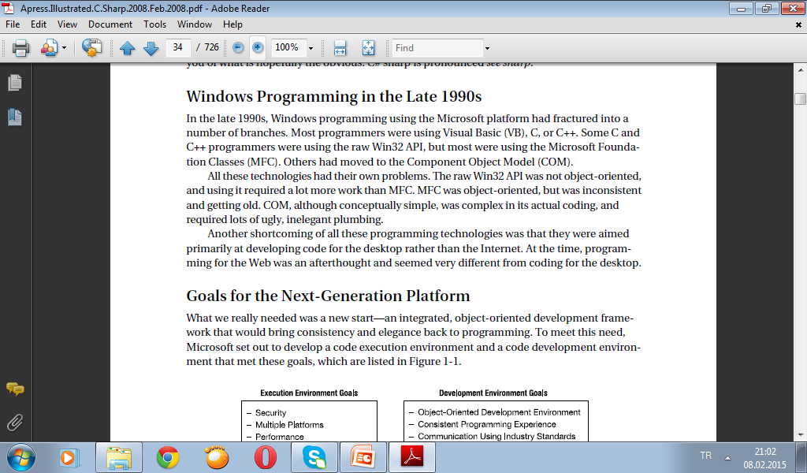

Slide 15
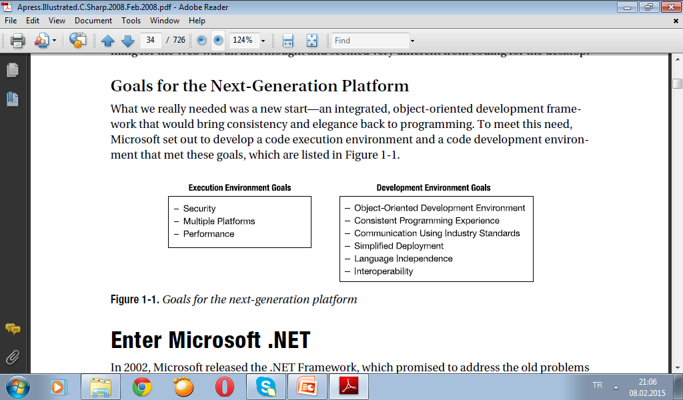

Slide 16
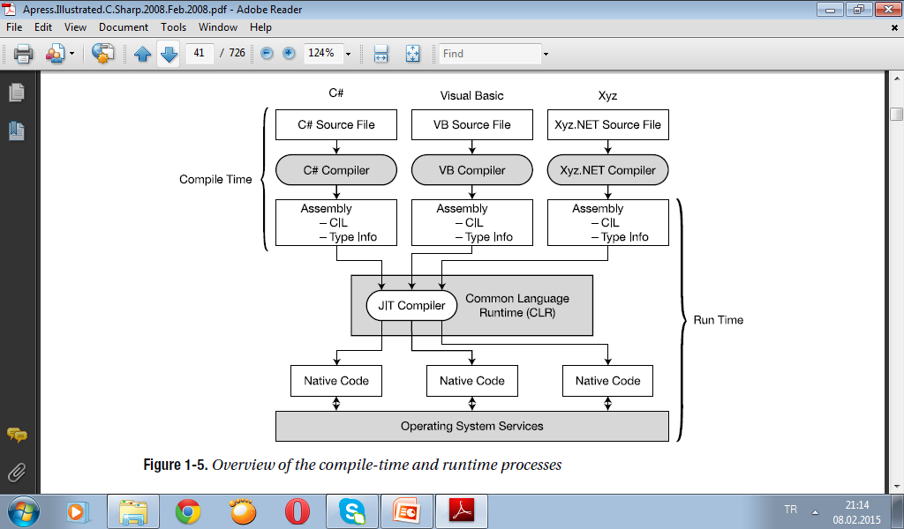

Slide 17
Compiling to Native Code and Execution
The program’s CIL is not compiled to native machine code until it is called to run. At run time, the CLR performs the following steps (as shown in Figure 1-4):
• It checks the assembly’s security characteristics.
• It allocates space in memory.
• It sends the assembly’s executable code to the Just-in-Time (JIT) compiler, which compiles portions of it to native code.
The executable code in the assembly is compiled by the JIT compiler as it is needed. It is then cached in case it is needed for execution again later in the program. Using this process means that code that isn’t called isn’t compiled to native code, and code that is called is only compiled once.

Slide 18
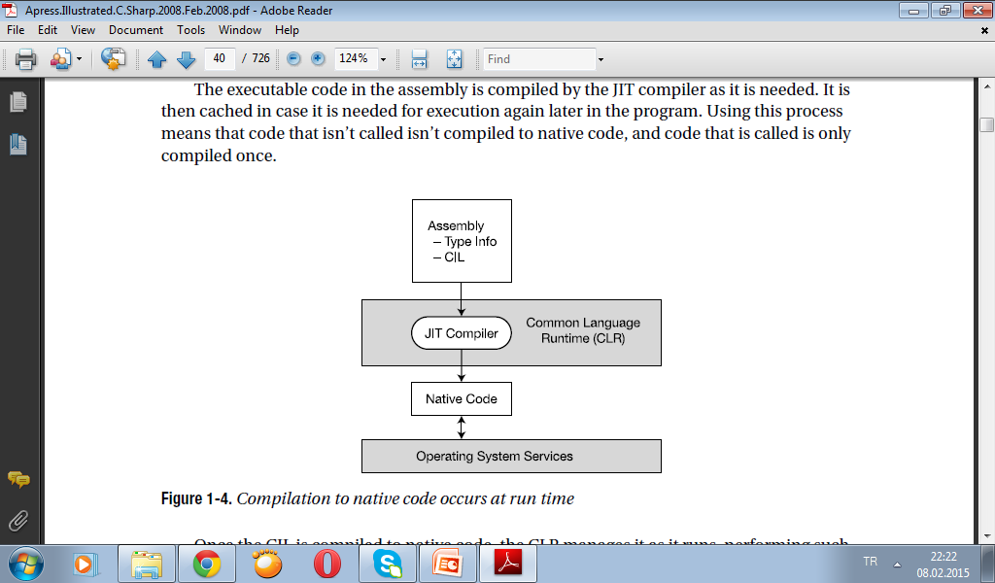

Slide 19
Once the CIL is compiled to native code, the CLR manages it as it runs, performing such tasks as releasing orphaned memory, checking array bounds, checking parameter types, and managing exceptions. This brings up two important terms:
• Managed code: Code written for the .NET Framework is called managed code, and needs
the CLR.
• Unmanaged code: Code that does not run under the control of the CLR, such as Win32 C/C++ DLLs, is called unmanaged code.
Microsoft also supplies a tool called the Native Image Generator, or Ngen, which takes an assembly and produces native code for the current processor. Code that has been run through Ngen avoids the JIT compilation process at run time.

Slide 20
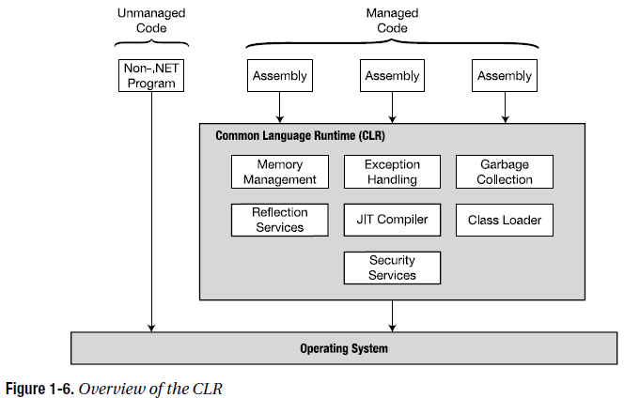
The Common Language Runtime (CLR)
The core component of the .NET Framework is the CLR, which sits on top of the operating system and manages program execution, as shown in Figure 1-6. The CLR also provides the following
Services:• Automatic garbage collection, • Security and authentication
• Extensive programming functionality through access to the BCL—including functionality such as web services and data services

Slide 21
Important Parts of the CLI
Although most programmers don’t need to know the details of the CLI specifications, you should at least be familiar with the meaning and purpose of the Common Type System and the Common Language Specification.
Common Type System (CTS)
The Common Type System (CTS) defines the characteristics of the types that must be used in managed code. Some important aspects of the CTS are the following:
• The CTS defines a rich set of intrinsic types, with fixed, specific characteristics for each type.
• The types provided by a .NET-compliant programming language generally map to some specific subset of this defined set of intrinsic types.
• One of the most important characteristics of the CTS is that all types are derived from a common base class—called object.
Common Language Specification (CLS)
The Common Language Specification (CLS) specifies the rules, properties, and behaviors of a .NET-compliant programming language.
The topics include data types, class construction, and parameter passing.

Slide 22
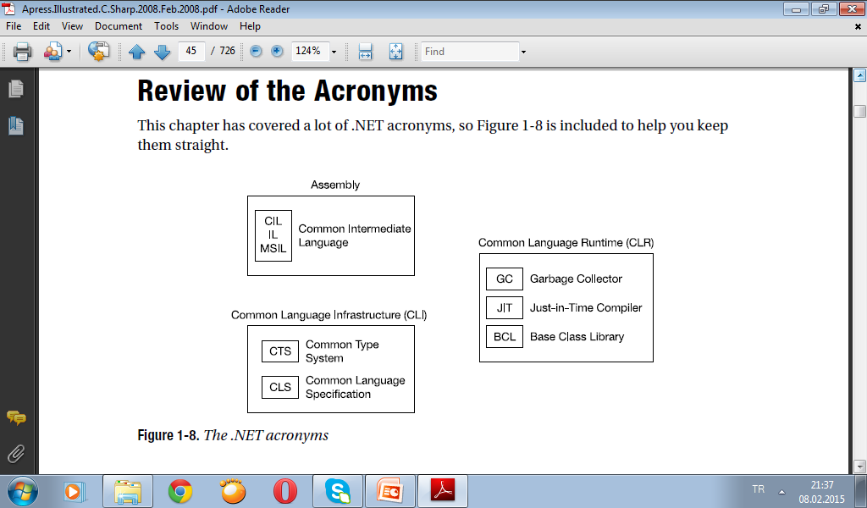

Slide 23
Why Do We Need Object-Oriented Programming?
Object-Oriented Programming was developed because limitations were discovered in earlier approaches to programming.
what these limitations are and how they arose from traditional programming languages.
Procedural Languages
C, Pascal, FORTRAN, and similar languages are procedural languages.
That is, each statement in the language tells the computer to do something: Get some input, add these numbers, divide by 6, display that output.
A program in a procedural language is a list of instructions.
For very small programs, no other organizing principle (often called a paradigm) is needed.
The programmer creates the list of instructions, and the computer carries them out.

Slide 24
Division into Functions
When programs become larger, a single list of instructions becomes unwieldy.
Few programmers can comprehend a program of more than a few hundred statements unless it is broken down into smaller units.
For this reason the function was adopted as a way to make programs more comprehensible to their human creators. (The term function is used in C++ and C. In other languages the same concept may be referred to as a subroutine, a subprogram, or a procedure.) A procedural program is divided into functions, and (ideally, at least) each function has a clearly defined purpose and a clearly defined interface to the other functions in the program.
The idea of breaking a program into functions can be further extended by grouping a number of functions together into a larger entity called a module (which is often a file), but the principle is similar: a grouping of components that carries out specific tasks.
Dividing a program into functions and modules is one of the cornerstones of structured programming, the somewhat loosely defined discipline that influenced programming organization for several decades before the advent of Object-Oriented Programming.

Slide 25
Problems with Structured Programming
As programs grow ever larger and more complex, even the structured programming approach begins to show signs of strain.
Analyzing the reasons for these failures reveals that there are weaknesses in the procedural paradigm itself. No matter how well the structured programming approach is implemented, large programs become excessively complex.
What are the reasons for these problems with procedural languages? There are two related problems. First, functions have unrestricted access to global data. Second, unrelated functions and data, the basis of the procedural paradigm, provide a poor model of the real world.
Let’s examine these problems in the context of an inventory program. One important global data item in such a program is the collection of items in the inventory. Various functions access this data to input a new item, display an item, modify an item, and so on.

Slide 26
Problems with Structured Programming
As programs grow ever larger and more complex, even the structured programming approach begins to show signs of strain.
Analyzing the reasons for these failures reveals that there are weaknesses in the procedural paradigm itself. No matter how well the structured programming approach is implemented, large programs become excessively complex.
What are the reasons for these problems with procedural languages? There are two related problems. First, functions have unrestricted access to global data. Second, unrelated functions and data, the basis of the procedural paradigm, provide a poor model of the real world.
Let’s examine these problems in the context of an inventory program. One important global data item in such a program is the collection of items in the inventory. Various functions access this data to input a new item, display an item, modify an item, and so on.

Slide 27
Characteristics of Object-Oriented Languages
İn general and C++ in particular
Objects
When you approach a programming problem in an object-oriented language, you no longer ask how the problem will be divided into functions, but how it will be divided into objects.
Thinking in terms of objects, rather than functions, has a surprisingly helpful effect on how easily programs can be designed.
This results from the close match between objects in the programming sense and objects in the real world.

Slide 28
What kinds of things become objects in object-oriented programs?
The answer to this is limited only by your imagination, but here are some typical categories to start you thinking:
Physical objects Automobiles in a traffic-flow simulation Electrical components in a circuit-design program Countries in an economics model Aircraft in an air-traffic-control system
• Elements of the computer-user environment Windows Menus Graphics objects (lines, rectangles, circles) The mouse, keyboard, disk drives, printer • Data-storage constructs Customized arrays Stacks Linked lists Binary trees
• Human entities Employees Students Customers Salespeople • Collections of data An inventory A personnel file A dictionary A table of the latitudes and longitudes of world cities
• User-defined data types Time Angles Complex numbers Points on the plane
• Components in computer games Cars in an auto race Positions in a board game (chess, checkers) Animals in an ecological simulation Opponents and friends in adventure games

Slide 29
Classes
In OOP ,objects are members of classes.
What does this mean?
Almost all computer languages have built-in data types. For instance, a data type int, meaning integer, is predefined in C++
You can declare as many variables of type int as you need in your program:
int day;
int count;
int divisor;
int answer;
In a similar way, you can define many objects of the same class, as shown in Figure.
A class serves as a plan, or template. It specifies what data and what functions will be included in objects of that class. Defining the class doesn’t create any objects, just as the mere existence of data type int doesn’t create any variables.

Slide 30
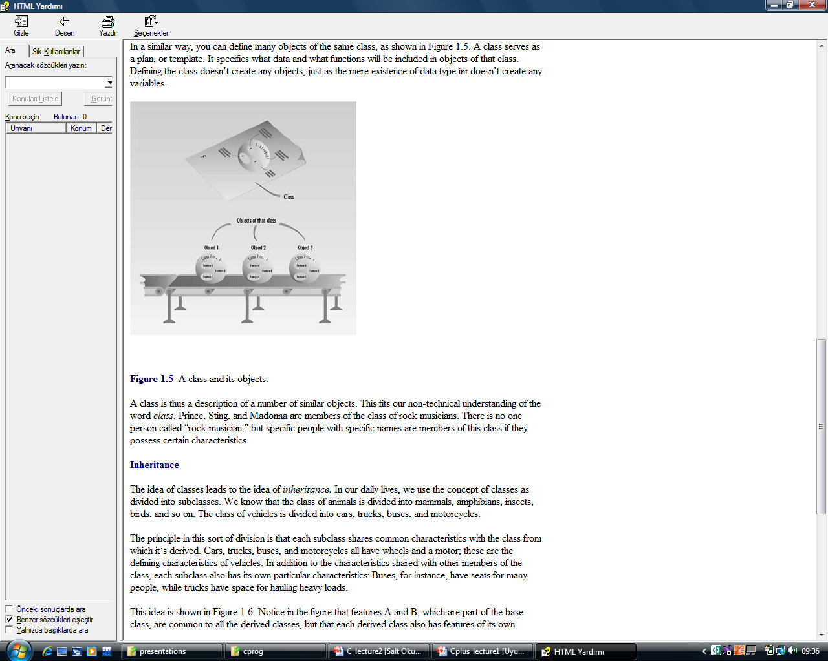
A class is thus a description of a number of similar objects.

Slide 31
Inheritance
The idea of classes leads to the idea of inheritance.
In our daily lives, we use the concept of classes as divided into subclasses.
We know that the class of animals is divided into mammals, amphibians, insects, birds, and so on. The class of vehicles is divided into cars, trucks, buses, and motorcycles.
The principle in this sort of division is that each subclass shares common characteristics with the class from which it’s derived. Cars, trucks, buses, and motorcycles all have wheels and a motor; these are the defining characteristics of vehicles. In addition to the characteristics shared with other members of the class, each subclass also has its own particular characteristics: Buses, for instance, have seats for many people, while trucks have space for hauling heavy loads.

Slide 32
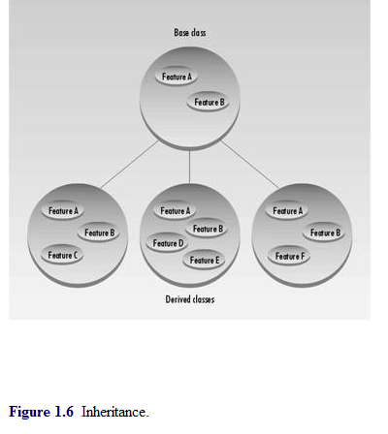
This idea is shown in Figure.
In the figure that features A and B, which are part of the base class, are common to all the derived classes, but that each derived class also has features of its own.
In a similar way, an OOP class can be divided into subclasses. In C++ the original class is called the base class; other classes can be defined that share its characteristics, but add their own as well. These are called derived classes.

